Slide 1
SSTV Radio (Repeater?) as payload
IIT Bombay Student Satellite Project

Slide 2
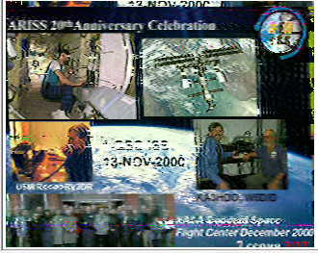
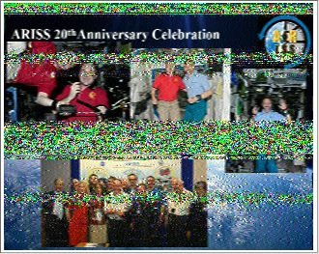

What is SSTV?
SSTV (Slow-Scan TV) is picture transmission method used mainly by amateur radio operators, to transmit pictures via radio.
Image is encoded to audio frequencies, transmitted through radio waves, received and decoded at the other end

Slide 3
The Complete Payload
Encoded Data of Image on Satellite
Audio signals
Transmission via antenna
Frequency modulation
Received at Ground Station
Demodulation
Decoding
Image

Slide 4
Another possible addition-Under analysis
A decoded SSTV could be transmitted to the satellite to be stored and transmitted by it.
The main challenge of reliability of signal reception is still to be understood.
Another challenge being the capability of the Ground Station setup, which is crucial for this section.
Addition of this component will complete the repeater concept in the satellite.
Notes:
The main reason of adding 2nd point is even though it is easy to attain, this has to be ensured for ground station.

Slide 5
Major Bottlenecks of Failure
Conversion of digital value of frequency to audio signal.
Storage of data

Slide 6
Conversion of digital value of frequency to audio signal.
SSTV transmission mechanism
The complete process requires audio output at certain value of audible frequency to be given as input to FM transmitter.
Some devices for digital data to audio output have been found but a detailed execution still has to be looked into.
Possible modules: AD9833

Slide 7
Storage of Data
Method of Transmission: PD90
Image size: 320x256 px
With average: (320x256 pixels)x (2 Bytes on average per pixel) = 160 kB
For 1 picture storage requirement: 160 kB
For more images we will be requiring more storage.
Solution: Space grade EEPROM AT69170E can be used for this purpose
The memory space available is 4 Mb which can be used in series

Slide 8
External Factors
Availability of FM Modules
FM modules in the amateur radio frequency range

Slide 9
On-Ground Testing
Link budget calculation-Evaluation of distance equivalent for transmission on ground for satellite.
Before integration testing of the setup
After integration testing of the setup

Slide 10
Requirements on Communication
Communication sub-system shall transmit all over the world at a certain duty cycle (50%).
They shall setup a ground station at IIT Bombay. - Ready
They shall design low-cost ground stations for other universities/villages.

Slide 11
Requirements on Control Subsystem
3 axis stability for antenna transmission

Slide 12
Requirements on Power Subsystem
A power requirement of around 3W will be required for transmitting circuit boards during normal transmission.
With inclusion of duty cycle, the power requirement can decrease.

